Slide 1


Smart Account
Project Release Plan
V 1.2 - 7/3/18
A Professional Accounting Software for You & Your Group
Team Member
Haoran Li Hang Yuan (Product Owner) Qingyuan He
Xuhua Feng Yujia Li (Initial Scrum Master)

Slide 2
About Smart Account
Smart Account is an Android app that allows users to track their and their groups' account information, helping users to better understand how their money 'disappears', generating reports and analysis of payments, and offering smart suggestions for users' future budget plan.
High level goals
Record
Android application connected to user accounts that allows users to record bill info individually or together.
Data Visualization & Reports Generation
Visualize data and generate reports to display bill history among different groups.
Budget Prediction
Give predicted budgets based on users’ personal settings and history bill info.

Slide 3
Sprint - 1
Project Release Plan – User Stories
As a developer, I need to be familiar with Android studio to develop the Android app efficiently. (8pts)
As a user, I need to record my new bill information. (8pts)
As a user, I need to review my history bill information. (8pts)
As a user, I need to edit my history bill information. (3pts)

Slide 4
Sprint - 2
Project Release Plan – User Stories
As a user, I need to know my future budget based on my history info. (8pts)
As a user, I need to know the weight of different categories of payment. (5pts)
As a user, I want to sign up my own account to share bill with others. (3pts)
As a user, I want an operating instructions. (3pts)

Slide 5
Sprint - 3
Project Release Plan – User Stories
As a user, I need visual diagrams to show my income and payment in the last few days/weeks/months. (8pts)
As a user, I need advice for saving money. (8pts)
As a user, I want to see a well-designed interface. (5pts)
As a user, I want to set goals for saving money. (3pts)

Slide 6
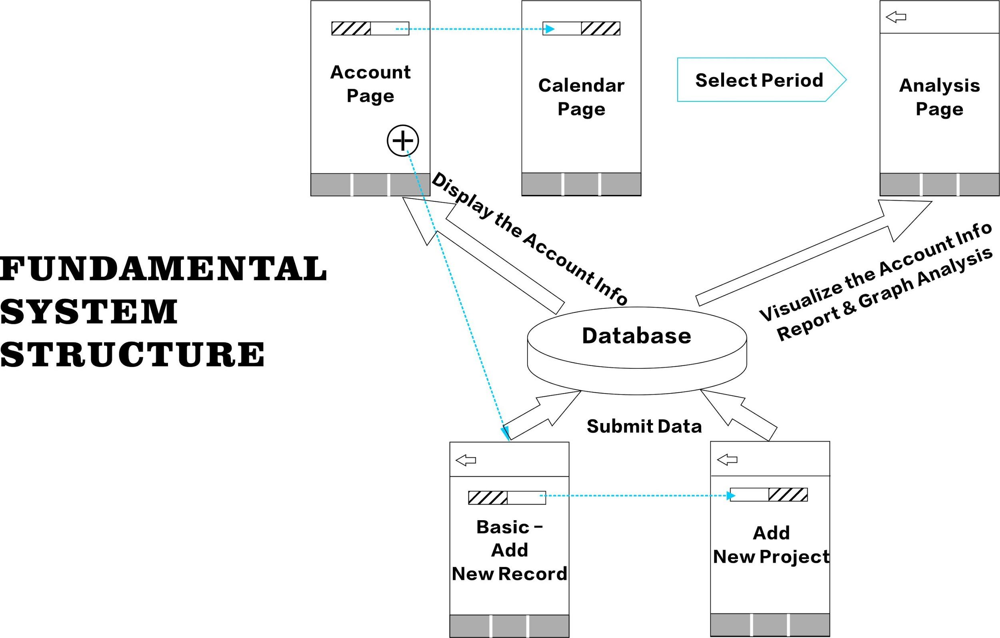
Project Release Plan – Architecture

Slide 7
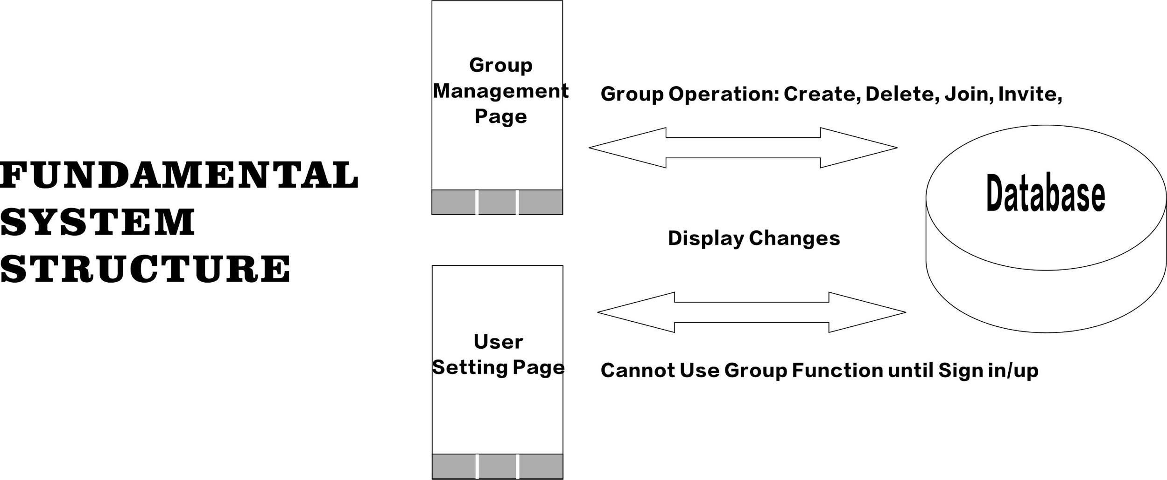
Project Release Plan – Architecture

Slide 8
Project Release Plan – Challenges/Risks
Challenges
No experience on developing a software
Teamwork management
Learn to work with unfamiliar technologies
Limited time for working together

Slide 9




Project Release Plan – Technology
Technology
Github, Java, Android Studio, Adobe Creative Suite

Slide 10
Thanks for Listening!
Smart Account

